Slide 1
Can Adapting A Workflow Builder Tool Improve the Effectiveness and Result Over Traditional Methods of the Onboarding Process?

Slide 2

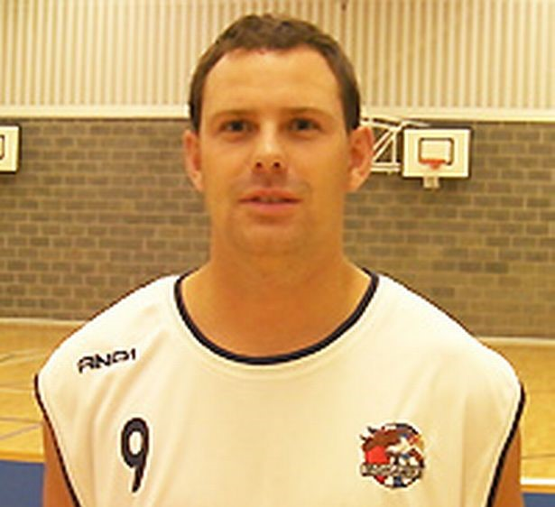
Introductions
Alan John Heslop DevOps Engineer/Student
Paul Graham Student Supervisor

Slide 3
Agenda
Topic | Speaker
Introduction to the Problem (Project Initiation) | Alan Heslop
Research Undertaken (Literature Review) | Alan Heslop
Description of the Approach | Alan Heslop
Requirements Elicitation and Analysis | Alan Heslop
Rationale for Technology Choices | Alan Heslop
Testing and Analysis of the Results | Alan Heslop
Evaluation | Alan Heslop

Slide 4
Introduction to the Problem
Employee onboarding issues

Slide 5

Introduction to the Problem
16pt Arial Bold text goes here for a callout
Digital transformation is key product for future projects. Using an outdated employee onboarding system using paper-trails and excel spreadsheets can become confusing and will affect the new hire.
Using partial-paper versions to track progress.
Hand signatures.
Lost track of paperwork.
Old outdated information
A manager has left his job and you need their approval, as part of the process
Overloaded with work within the first few days.
Footnotes/references, if needed, appear here in Arial 9pt. Text grows bigger as lines are added. Copy and paste this box onto other slides where footnotes are needed.

Slide 6
Introduction to the Problem
16pt Arial Bold text goes here for a callout
Reviewing a HR conference survey by process.st showed that there were multiple areas of concern, and these were the most notable with personal experience.
16.3%
19.8%
18.6%
2x
Coordination
Lack of communication and clear processes and information overload can make the new hire uneasy.
*assignment groups/emails
Manual Tasks
19.8% of HR professionals explained there were to many checklists, with no automation or consistency.
*automation/central repo
Tools and Technology
18.6% of HR professionals found that using many different systems were confusing, and often ran into issues.
*code simplicity CI/CD
Employee Turnover
It’s proven that a negative onboarding experience produces a higher employee turnover. 2x likely to look for a different job
“AUTOMATION APPLIED TO AN INEFFICIENT OPERATION WILL MAGNIFY THE INEFFICIENCY” – BILL GATES

Slide 7
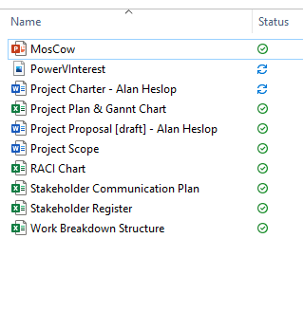








Terms of Reference
RACI Chart
Used to record responsibility assignments.
Initial Meeting/Finalise
First meeting to understand the requirements.
MoSCoW
Must have, should have, could have and won't have.
GANNT Chart
A GANNT chart to ensure dates and processes are completed on time.
Stake Holder Commuincation Plan and WBS
Used to better connect with the stakeholders.
Create Project Scope
Listing specific goals, deliverables and tasks.
Create Power V Interest Chart
Used to categorise the stakeholders.
Create Stake Holder Register
Information stored about the stakeholder.

Slide 8
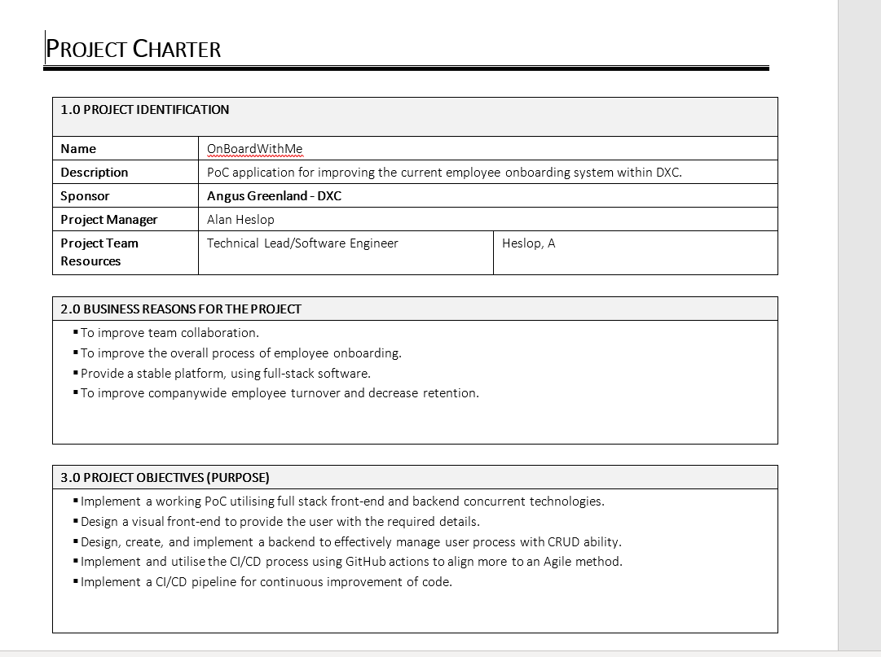
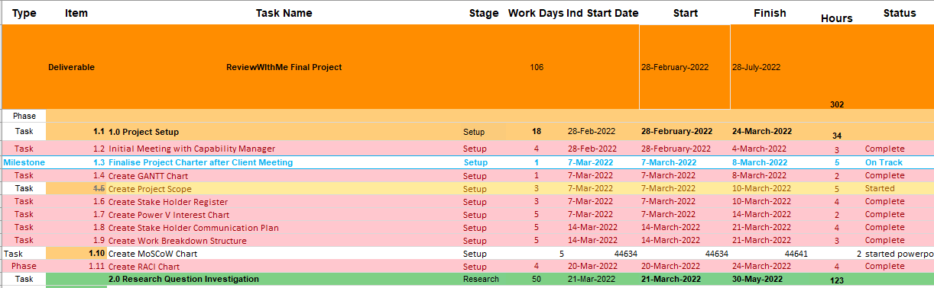
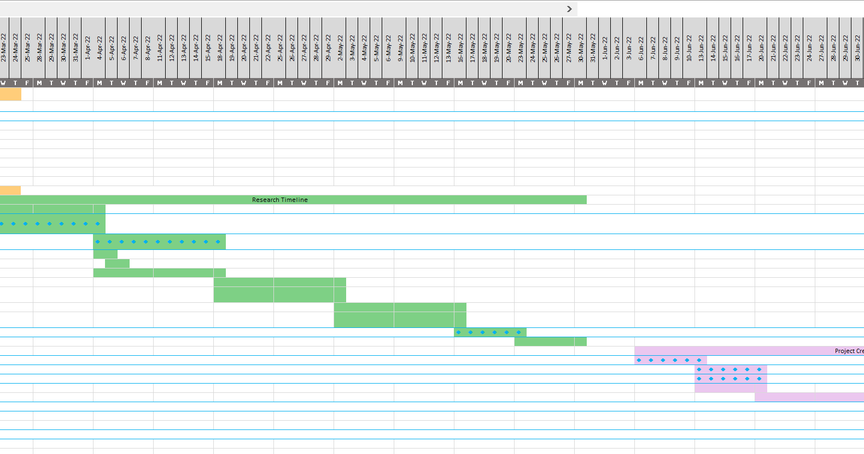
Planning Documentation #1
Project Charter
GANNT Chart
Is the color of milk and fresh snow, the color produced by the combination of all the colors of the visible spectrum.
Is the color of milk and fresh snow, the color produced by the combination of all the colors of the visible spectrum.

Slide 9
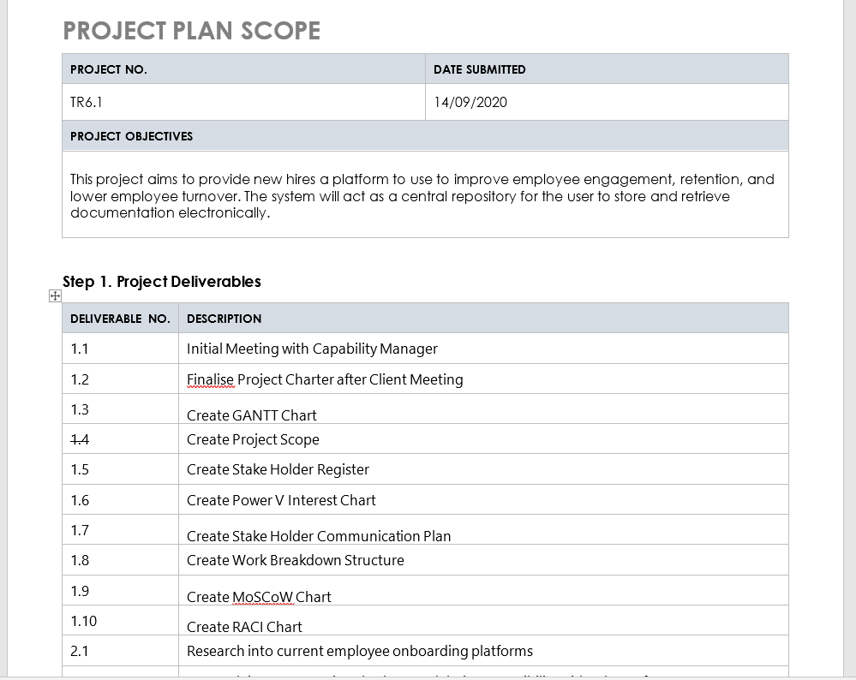
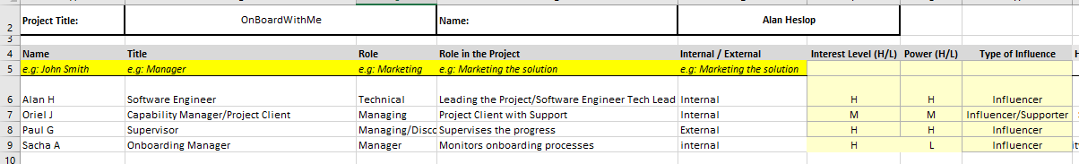
Planning Documentation #2
Project Scope
Stake Holder Register
Is the color of milk and fresh snow, the color produced by the combination of all the colors of the visible spectrum.
Is the color of milk and fresh snow, the color produced by the combination of all the colors of the visible spectrum.

Slide 10
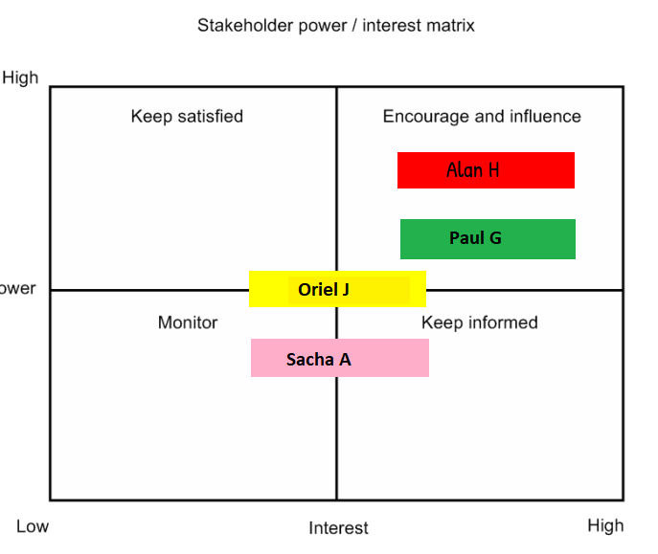
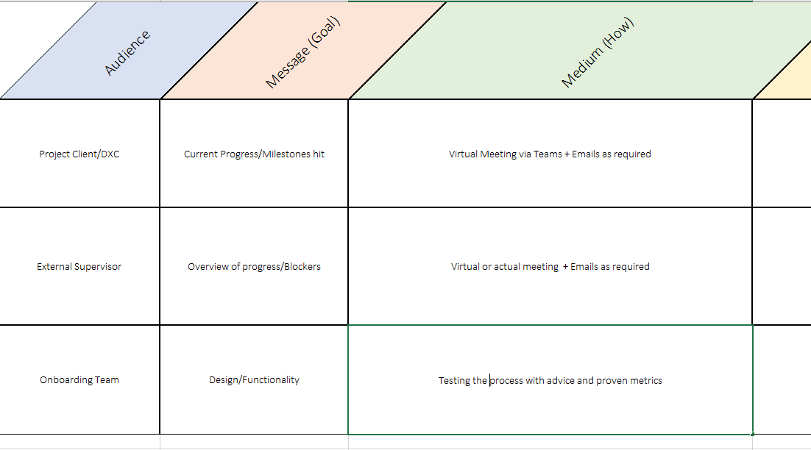
Planning Documentation #3
16pt Arial Bold text goes here for a callout
Power v Interest
Stakeholder Comms Plan
Is the color of milk and fresh snow, the color produced by the combination of all the colors of the visible spectrum.
Is the color of milk and fresh snow, the color produced by the combination of all the colors of the visible spectrum.

Slide 11
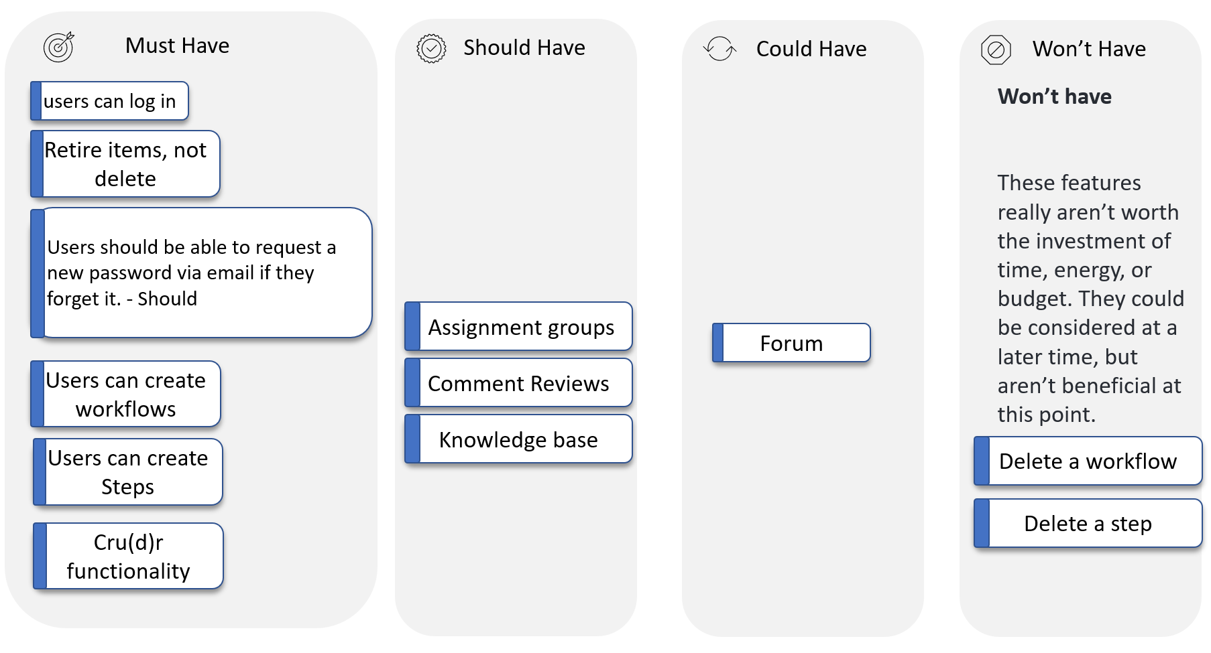
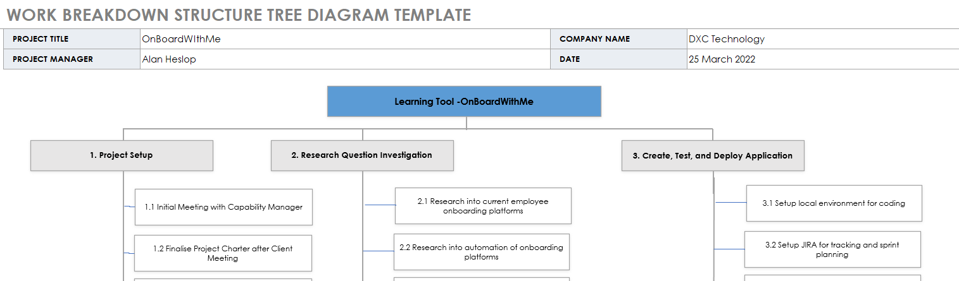
Planning Documentation #4
Work Breakdown Structure (WBS)
MoSCoW Chart
Is the color of milk and fresh snow, the color produced by the combination of all the colors of the visible spectrum.
Is the color of milk and fresh snow, the color produced by the combination of all the colors of the visible spectrum.

Slide 12
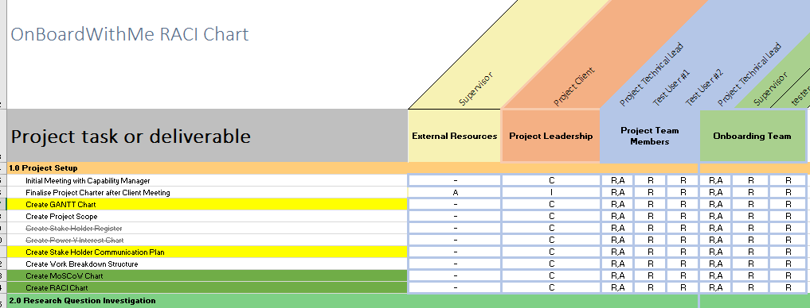
Planning Documentation #5
RACI Chart
Is the color of milk and fresh snow, the color produced by the combination of all the colors of the visible spectrum.

Slide 13
Problem Introduction
16pt Arial Bold text goes here for a callout
Social, Ethical, Legal and Professional Issues

Slide 14
Research Undertaken
Areas of research to better understand the issue

Slide 15
Research Undertaken
Areas of Research
Current failures of employee onboarding.
Comparison of programming languages I have experience with (Flask vs Django).
Cloud Hosted SQL or Local Django SQL DB.
How did employee onboarding react to COVID-19.
GitHub Commit/Testing.

Slide 16
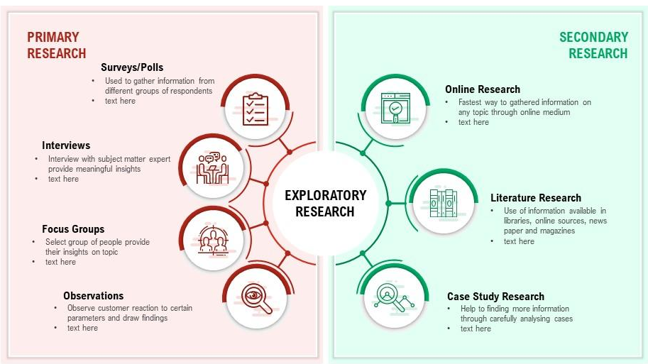
Research Undertaken
Research Types Used
Research Methodology Used
The most useful research type utilised for this project was primary and secondary research.
Primary:
Primary researched involved creating meetings, templates, and reviewing their current website to understand their vision.
Secondary:
Secondary research involved articles, company blogs, and research journals.
Exploratory research methodology was chosen:
Chosen because of the ability to identify the problem, create a hypothesise, design the methodology, collect and analyse data, and look at other styles to provide more context.
Identify the problem – issue with retention and turnover with a link to onboarding.
Hypothesise – I feel it would be best to create a tool in order to add in items which appear up most in reasons for turnover.
Collect and analyse data – noticing that paperwork, unclear goals, and feeling a lack of control has been previously picked to be failures.
Avenues for further research – extensive studies using different types of people by age, sex, religion. To see if there’s any markers for understanding. Demographics.

Slide 17
Research Undertaken
Outcome of research
Research Methodology Used
Disadvantages
Advantages
Helpful for being able to narrow down the issue(s), which may be previously studied.
Flexible methodology. It’s free to use and apply to your project.
Lack of results primarily due to lack of knowledge on the topic.
Exploratory results can often generate other methodologies results such as qualitive.

Slide 18
Approach
Why and How, due to exploratory methodology

Slide 19
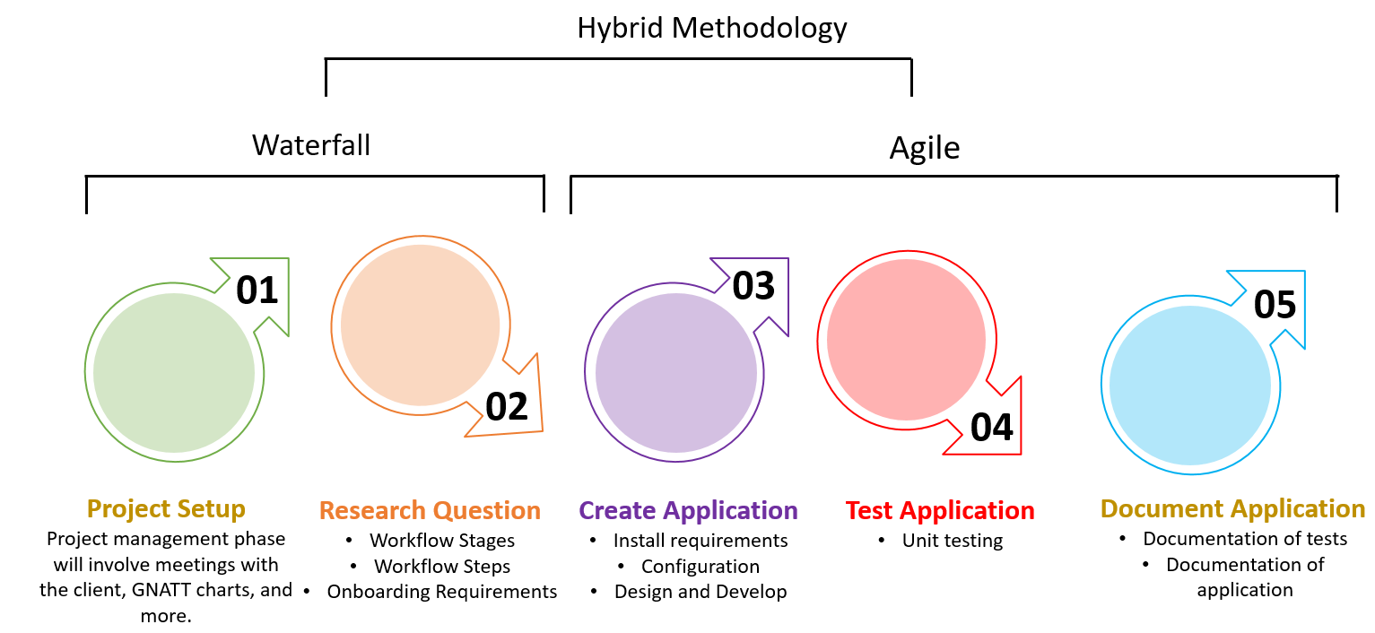
Approach

Slide 20
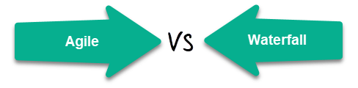

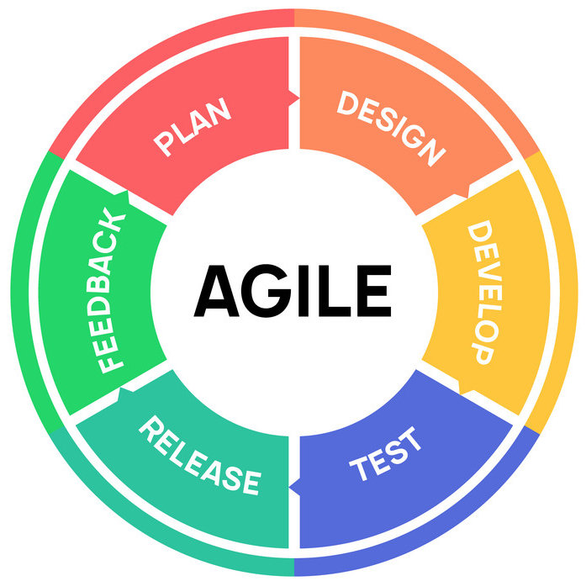
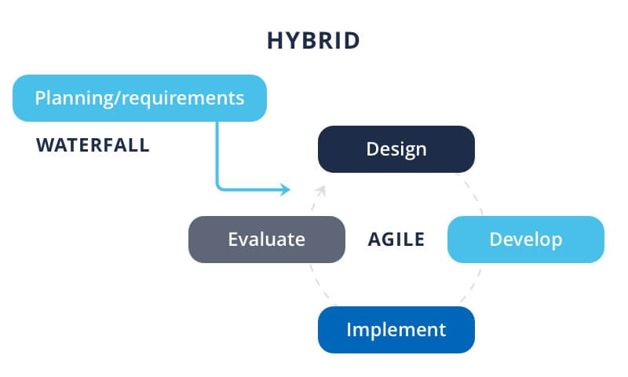

Approach
Comparison between methodologies
Waterfall
Agile
Hybrid
After researching which approach would be best, Waterfall had too many pitfalls for practical:
The end goal wasn’t clearly defined.
No full picture of all the requirements, as working in sprints.
Using continuous testing in and feedback in order to progress.
I can use this only for the project documentation side.
Knowing that project planning would be waterfall based, I need an agile outlook for design:
Throughout sprints the project may change requirements.
Work quickly to see progress.
Stakeholders want to have updates at every sprint.
Due to the previous 2 approaches being heavily linked in this project, Hybrid was chosen:
Keeping on track with documentation using waterfall
Due to experience using the sprints feature of SCRUM, I was able to release increments of the product for review.
*adopted a Kanban approach, then changed to SCRUM Agile on project change.

Slide 21
Approach
Comparison between methodologies
After speaking with the client and researching, the Proof of Concept (PoC) must:
View workflows
Attach to a workflow
Upload items to ‘Steps’
User profile
Ability to remove (or retire) older workflows not in use.
Validation on workflows to prevent duplication.
The PoC will concentrate on a portion of the application.

Slide 22
Requirements Elicitation and Analysis
What were the clients ideas, visions, requests

Slide 23
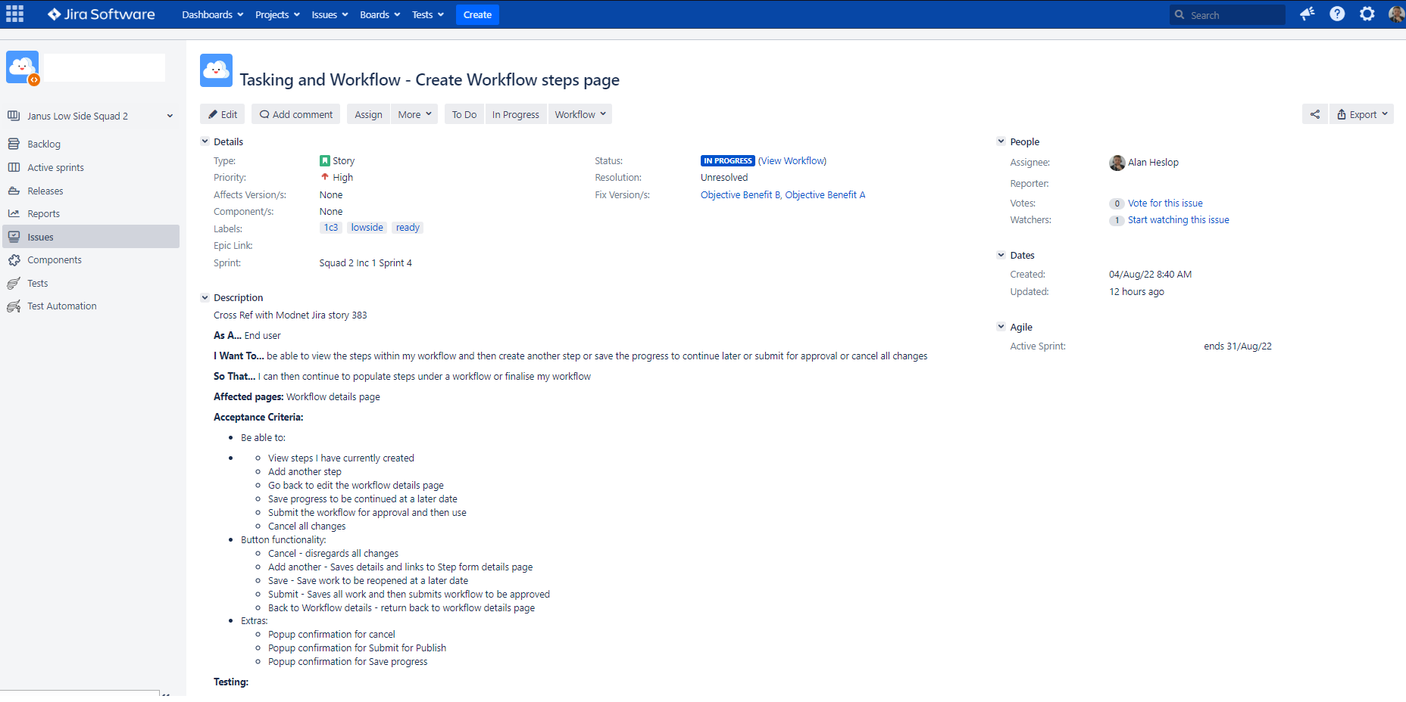
Requirements Elicitation
16pt Arial Bold text goes here for a callout
Platform for User Stories
User Stories
User stories were introduced to be able to pinpoint certain items in the sprint. The layout of the stories helped to better understand what the real requirements were.

Slide 24
Requirements Elicitation
Functional and Non-Functional Requirements
Functional Requirements
Non-Functional Requirements
User Profile
Name
Profile photo
Workflow Attached
Progress of Onboarding
Workflows
Add new workflow
Attach yourself to a workflow
Assigned a manager
Steps in a workflow
Add new step
Review comments from supervisor on step
Cross browser compatibility
Logging (timesheets)
Documented systems (code and user functionality)
99% uptime
User friendly
Performance
Usability
Reliability and scalability
Safety

Slide 25
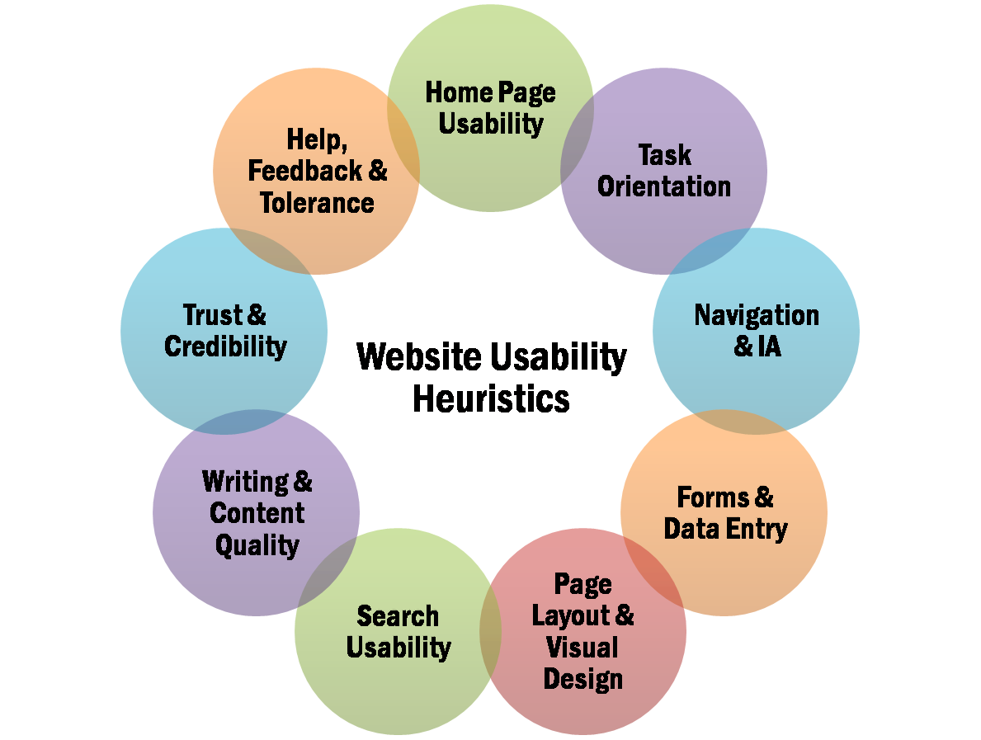
Requirements Elicitation
Hardware and Software Constraints
Use a language that has support and updates
Python Django was used due to previous learning on University course.
Windows-Based operating system due to DXC Developer laptops primarily being Windows.
Ability to be cloud-native and serverless.

Slide 26
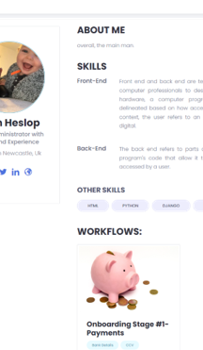
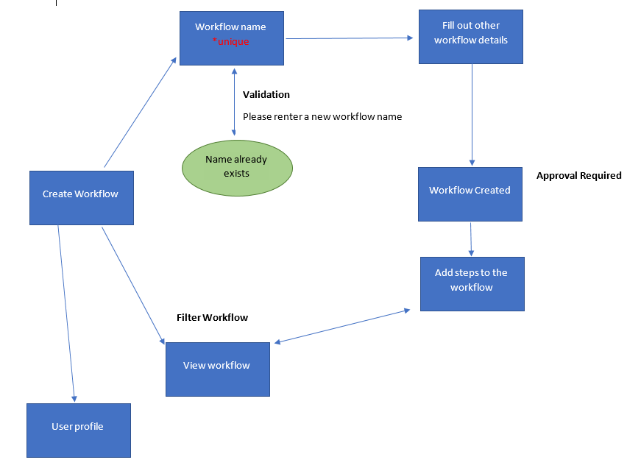
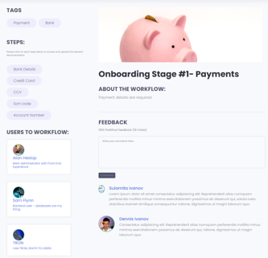
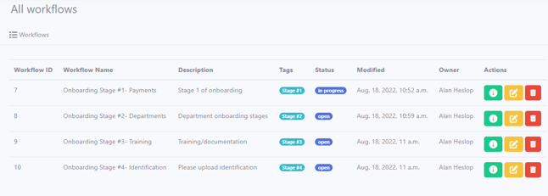
Requirements Elicitation
Design Documentation
The ability to use up to date technology such as CSS, HTML, and JavaScript allows for a fluid design which can be spanned over multiple devices.
Using this method can allow employees on the go to receive a know method of being kept up to date.

Slide 27
Rationale for technology choices
Justification of tools and technologies used throughout.

Slide 28
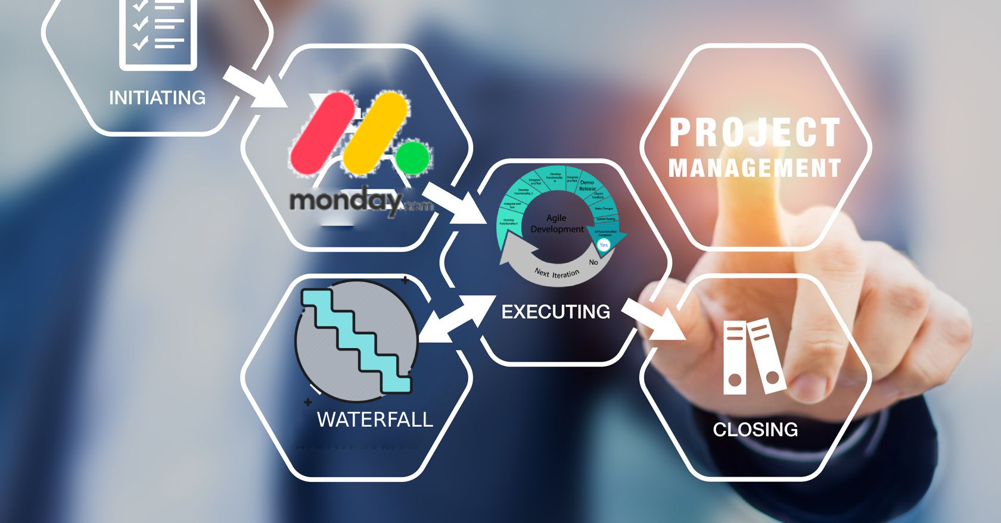
Rationale for technology choices
Technologies used – Project Planning
Project planning tools able to help achieve my project goal:
Monday.com
Waterfall (project planning)
Agile (development/sprints)

Slide 29

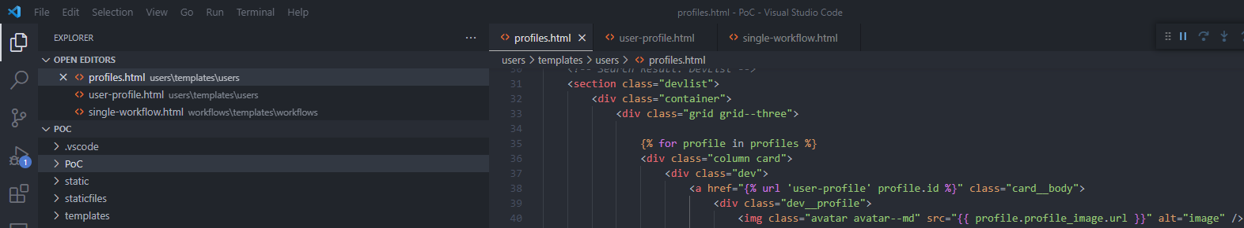
Rationale for technology choices
Technologies used - Development
Development tools able to help achieve my project goal:
Python Django
HTML 5
CSS 5
SQL DB
GitHub
Visual Studio Code

Slide 30
Analysis and Testing
Analysing and Testing the Final Product

Slide 31
Evaluation
Final Thoughts

Slide 32
Evaluation
Challenges
Changed project with a weeks remaining before hand-in.
Developed and enhanced prior skills learned from previous modules.
Contacting the correct departments for assistance.
Scrum sprints worked well.
Conclusion
As a PoC the usability and cost factors were free. This is good due to requiring at least 99% uptime.
Customer was happy with the provided product and explained they would like for me to collate all data/information up and send it across to the onboarding team. I would be working with them to set up the same environment if need be.
Understanding Django’s models structure helped me better develop my skills with foreign-keys, many to many relationships etc.
Although a PoC, I ensured that I did not go out of scope and add in functionality that could be show to use with future increments.
CUSTOMER NAME Curabitur eget massa
LOCATION Wurabitur leget massaty
INDUSTRY Sed ac nunc ut velit
DXC SERVICES Duis vulutate massa vel placerat tincidunt, nec miquis
WEBSITE Aaenean egesta magna sed
Reflection
Unfortunately changing project after 5 months seriously handicapped my time, motivation, and idea. Once I was able to select an area to focus on – it became apparent this would be a rush.
Decision making earlier on would have prevented the idea of what programming language and database to use.
Working individually without the real skill knowledge was a problem – next time, I would reach out when in a problem area.

Slide 33

Evaluation cont
Further Recommendations
Research into cloud providers for hosting.
Research into securing of information within the cloud environment (user data, credits cards etc).
Further research into addons to Python Django to make the code flow dynamically.
Further discussions with support team, with templated requirements.
Departmental permissions.

Slide 34

Demonstration of product

Slide 35
Questions

